Slide 1
Cab Booking Application

Slide 2
Technologies
Java 8
Spring Boot
Spring Security
Angular | React
PostgreSQL | MYSQL
Maven | Gradle

Slide 3
Problem Statement
To Create an Application for Online Cab Booking
Customer should be able to view the list of available cabs.
Customer should be able to book cab for desired location from a certain location.
Admin should be able to perform below operations:
1. Cab Management
2. Driver Management
3. Booking Management

Slide 4
Plan
Design
Generate the skeleton as per class design provided
TDD approach
Identify test cases for each module
Write Failing Test cases
Convert the Test Cases in GREEN
Implement the case study in incremental manner

Slide 5
Modules
Login Module
Customer Module
Admin
Module
Driver Management Module
Cab
Management Module
Booking
Management Module

Slide 6
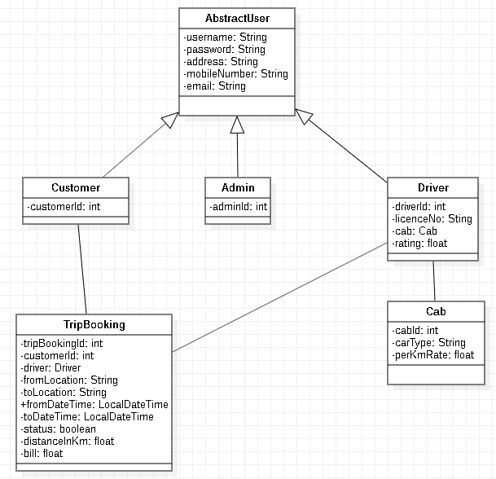
Class Design [POJO Classes]
1
1
1
1
M 1

Slide 7
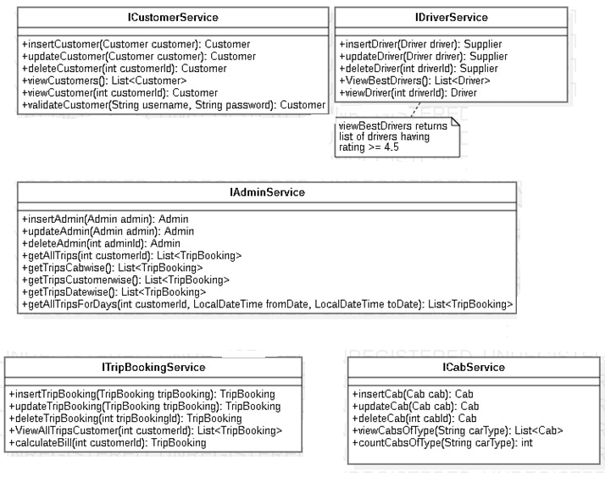
Class Design [Service Interface]

Slide 8
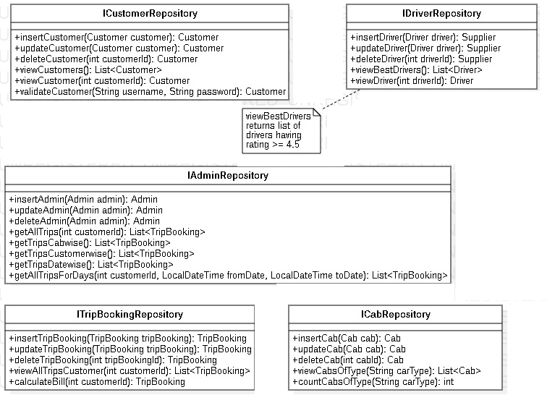
Class Design [Repository]

